Slide 1
The Hermitage Group
Dashboard Blueprint:
Beer Restaurant Success
Visualizations from Tableau

Slide 2
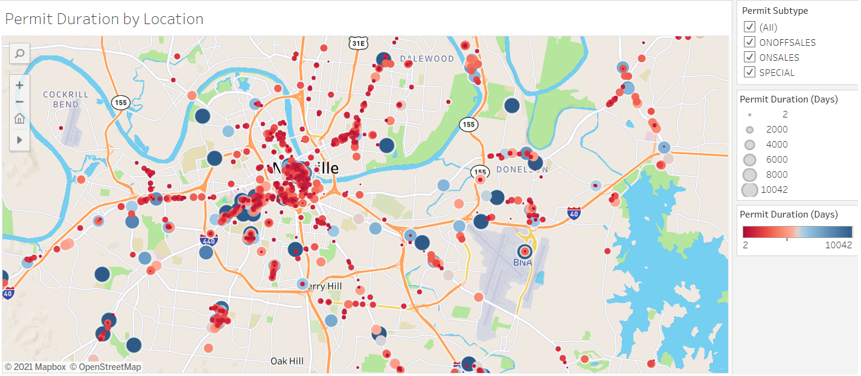
Permit Duration by Location
The large Blue dots represent permits that have been active for longer periods
The smaller Red dots represent locations that have permits issued more recently

Slide 3
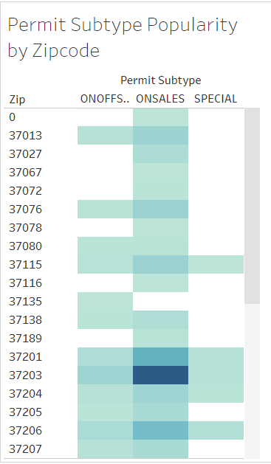

Active Beer Permits by Zip
Zip Codes closest to downtown (lower Broadway, Midtown and East Nashville) have the highest quantity of active Permits

Slide 4
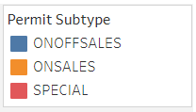
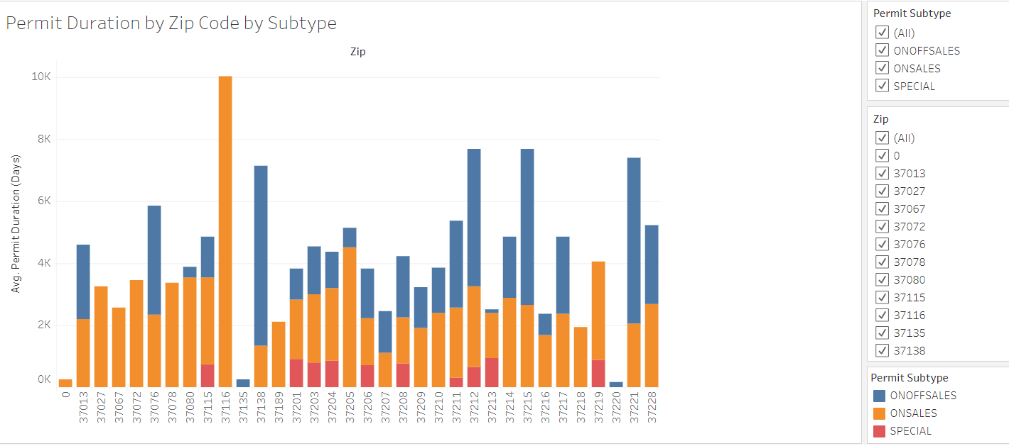
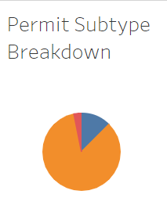
Permit Duration by Zip; Permit Type Breakdown
However, the areas further away from Downtown Nashville have a longer average permit duration
Majority of active permits are On Site Sales

